Slide 1
South Texas Judges and Commissioners
Association Conference
June 12, 2019
Overview of Community Supervision and Corrections Departments (Adult Probation) in Texas

Slide 2
254
Counties
TDCJ
122
CSCDs
3,039 Adult Probation
Officers as of Nov. 2018
Community Supervision & Corrections Departments
County Judges & Commissioners
469
District Judges
Prosecutors
331 District Attorneys
2,829 Assistant District
Attorneys
517
County Court at Law Judges
Defense Attorneys
Service Providers
Notes:
Texas Adult Probation System
Calculated based on information in the Texas State Directory.
Update rarely

Slide 3
CSCD
Statutory Authority
Article 42.A of the code of criminal procedure
Chapter 76 of the government code
Chapter 509 of the Government Code

Slide 4
Statutory Authority
Counties and CSCDs
  Government Code, Chapter 76 (Section 76.008):
  County’s responsibility is to provide physical facilities, equipment, and utilities for CSCDs
  Government Code, Chapter 509 (Section 509.012):
  If TDCJ-CJAD determines the CSCD is not receiving the support that meets the standards for minimum support, CJAD may refuse or suspend State Aid to the CSCD

Slide 5
Process to Community Supervision
Arrest
Charge
File with prosecutor
Indictment or information
Arraignment
Trial (plea agreement)
Pre-sentence investigation
Punishment hearing
Probated sentence
Terms of supervision

Slide 6
Eligibility to be a
Community Supervision Officer
Bachelor’s degree in human services field
Cannot be a peace officer
Cannot be on probation / parole
certification within first year of employment
Depending on tenure, 40-80 hours of professional skill based training each biennium

Slide 7
Caldwell, Comal, and Hays CSCD
Vision Statement
Promote continuous improvement and accomplish permanent change in the lives of others thereby creating a safe community.

Slide 8
Caldwell, Comal, and Hays CSCD Mission Statement
Serve the criminal courts
Protect the community
Provide rehabilitative opportunities
sanction

Slide 9
Caldwell, Comal, and Hays CSCD
Core Values
Accountability
Collaboration
Creativity
Integrity
Leadership
Perseverance
Professionalism
Teamwork

Slide 10
TBCJ
JAC
TDCJ
CJAD
Judicial oversight of 122 CSCDs
368,871 offenders¹
$246.3 million in FY2019 Formula and Grant Funding
The Texas Board of Criminal Justice (TBCJ) and TDCJ-CJAD are advised by the 12 member Judicial Advisory Council (JAC)
  6 members are appointed by the chief justice of the Texas Supreme Court
  6 members are appointed by the presiding judge of the Texas Court of Criminal Appeals
As of August 2018

Slide 11
Community Supervision in Texas
TDCJ- CJAD
Oversight of 122 CSCDs through standards, audits, etc.
Coordinates statewide treatment programs
Provides about two-thirds of CSCDs funding
State Oversight
CSCD
Supervise Offenders based on court order and effective interventions
Provide local services and treatment programs
Local
Probation Office
Local Judges
Appoint CSCD Director
Appoint Fiscal Officer
Approve CSCD budget and Strategic Plan
Local Oversight

Slide 12
Origination of Caldwell, Comal, and Hays CSCD
Founded in 1969 by a grant
Grant was through the sociology department at texas state university
Purpose of grant was to develop probation services in rural texas counties
One probationer in 1969 serving three counties

Slide 13
Caldwell, Comal, Hays:
Board of Judges
SEVEN district judges
SIX county court at law judges

Slide 14
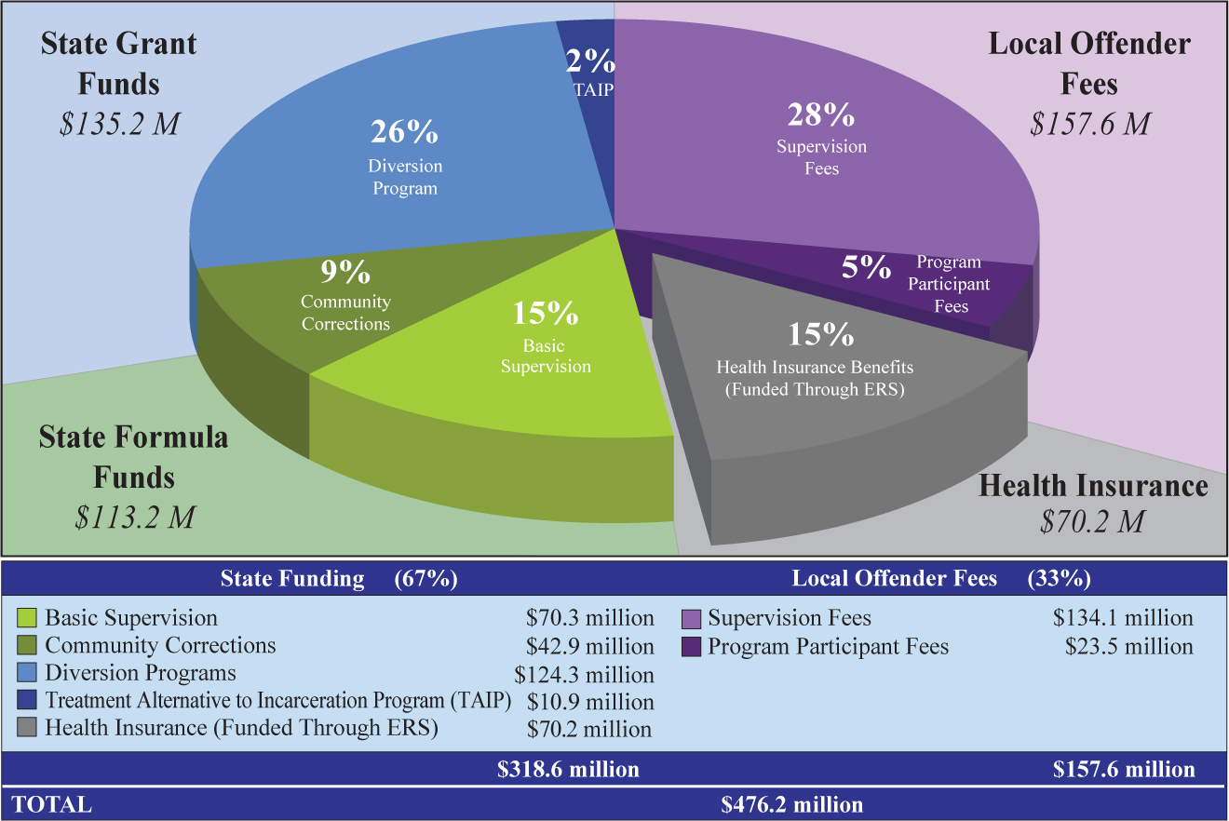
Sources of Funding

Slide 15
Caldwell, Comal, Hays CSCD - All Revenue (end of FY2018)

Slide 16
Caldwell, Comal, Hays CSCD
State Aid vs. Locally Generated Revenue
(end of FY2018)

Slide 17
Caldwell, Comal, Hays CSCD Expenses
Auditing Services
Community Service Supplies
Contract Services for Offenders
Information Technology (Equipment / Maintenance / Software)
Legal Counsel
Materials for Programs
Payroll Services
Professional Licensures
Salaries, Fringe, Retirement
Supplies for Urinalysis
Vehicles, Training, Travel, Lodging, Per Diem
Etc.

Slide 18
Texas Criminal Justice System
Arrest/Sentencing
Incarceration:
CID, State Jail
141,585 offenders²
Community Supervision
368,871 offenders²
228,255 Felony²
140,616 Misdemeanor²
Violations
Intermediate Sanctions
Specialized Caseloads
Residential Treatment
Drug Courts
23,026 Felony Revocations¹
Parole
86,855 offenders²
Continued Violations
¹ FY2018, Revocations to TDCJ
As of August 2018

Slide 19
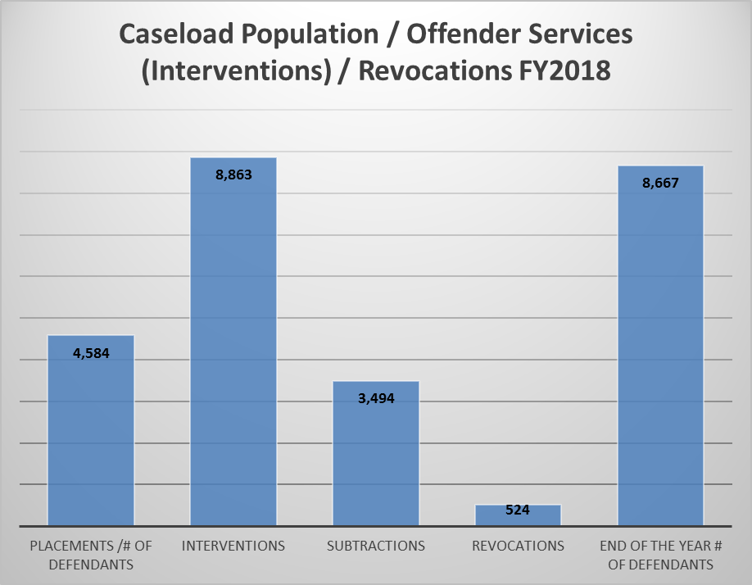
Caldwell, Comal, Hays Population Data (8/31/208)

Slide 20
Responsibilities of TDCJ-CJAD
Distribute formula and grant funds
Develop standards, including best-practice treatment standards
Approve Strategic Plans and budgets
Conduct program and fiscal audits
Provide training and certification of community supervision officers

Slide 21
Responsibilities of TDCJ-CJAD
Provide technical assistance to CSCDs
Provide direction on allowable/unallowable expenditures
Evaluate program effectiveness
Report statistical data to federal, state and local governing bodies
Maintain the Community Supervision Tracking System

Slide 22
Role of CSCDs
Administer and provide pretrial services and diversion programming for the courts
Prepare presentence investigation reports
Conduct criminogenic risk/needs assessments prior to and/or during the term of supervision
Supervise, monitor compliance and rehabilitate offenders placed on community supervision
Provide differential supervision for offenders

Slide 23
Role of CSCDs
Collect and/or monitor the collection of court ordered restitution, fines, and/or fees
Report and address violations through department’s progressive sanctions and interventions models
Refer probationers to appropriate community resources, CSCD or TDCJ programs
Report statistical and financial data

Slide 24
Caldwell, Comal, and Hays CSCD Organization
Five divisions:
Administrative division
Caldwell county cscd
Comal county cscd
Hays county cscd
Programs division

Slide 25
Caldwell, Comal, and Hays CSCD Personnel
95 employees:
Administrators
Officers
Counselors
Clerical staff

Slide 26
Evidence-Based Principles
Evidence-Based Principles
Collaboration
Organizational Development
By using the best available evidence from research as the foundation of policy development and program implementation, supervision can be individualized to
address offender
risks and needs

Slide 27
Evidence-Based Principles
Provide Measurement
Feedback
Measure Relevant Practices
Engage On-Going Support in Communities
Increase Positive Reinforcement
Skill Train with Directed Practice
Target Interventions
Enhance Intrinsic Motivation
Assess Actuarial Risk/Needs

Slide 28
Substance Abuse Continuum
No Treatment with Urinalysis Surveillance
Supportive Outpatient
Intensive Outpatient/
Day Reporting Treatment
Short-term Contract Residential
CCF
SC-ISF SA Track
SAFPF
The more restrictive the treatment environment…
…the greater the need for structured transition back into the community through aftercare and differential supervision

Slide 29
Programs Within CSCDs
Community Service
Variety of Specialized Caseloads, i.e. Mental Health, Sex Offender, etc.
Statutorily Required Classes, i.e. Drug Education, DWI, etc.
Female Offenders
Substance Abuse – Residential/Outpatient

Slide 30
Programs Within CSCDs
● Residential Facilities
  CSCD Operated
    Substance Abuse Treatment Facilities
    Court Residential Treatment Centers
    Intermediate Sanction Facilities (ISF)
    Dually Diagnosed Residential Facilities
  State contracted (located within TDCJ)
    State-Contracted ISF
    Substance Abuse Felony Punishment Facilities
● Battering Intervention and Prevention Programs
(operated by vendors & some CSCDs)

Slide 31
Caldwell, Comal, Hays CSCD
Diversion Programs, Specialized Caseloads, and Specialty Courts
Contract Services for Offenders (Residential, Psychological Evaluations) (CA, CO, HA)
Day Treatment Program Outpatient Substance Abuse Services (CA, CO, HA)
Drug Courts (CA, CO)
DWI Court (CO)
Mental Health Caseloads (CA, CO, HA)
Moral Reconation Therapy (CA, CO, HA)
Outpatient Substance Abuse Treatment (CA, CO, HA)
Pretrial Bond Caseloads (CA, CO, HA)

Slide 32
Caldwell, Comal, Hays CSCD
Diversion Programs, Specialized Caseloads, and Specialty Courts
Re-Entry Court (HA)
Review Court (CA)
Sex Offender Caseloads (CA, CO, HA)
Substance Abuse Felony Punishment Facility Caseload (CA, CO, HA)
Substance Abuse Treatment and Aftercare Caseloads (CA, CO, HA)
Supportive Outpatient Substance Abuse Treatment Aftercare (CA, CO, HA)
Veterans Courts (CO, HA)
Etc.

