Slide 1
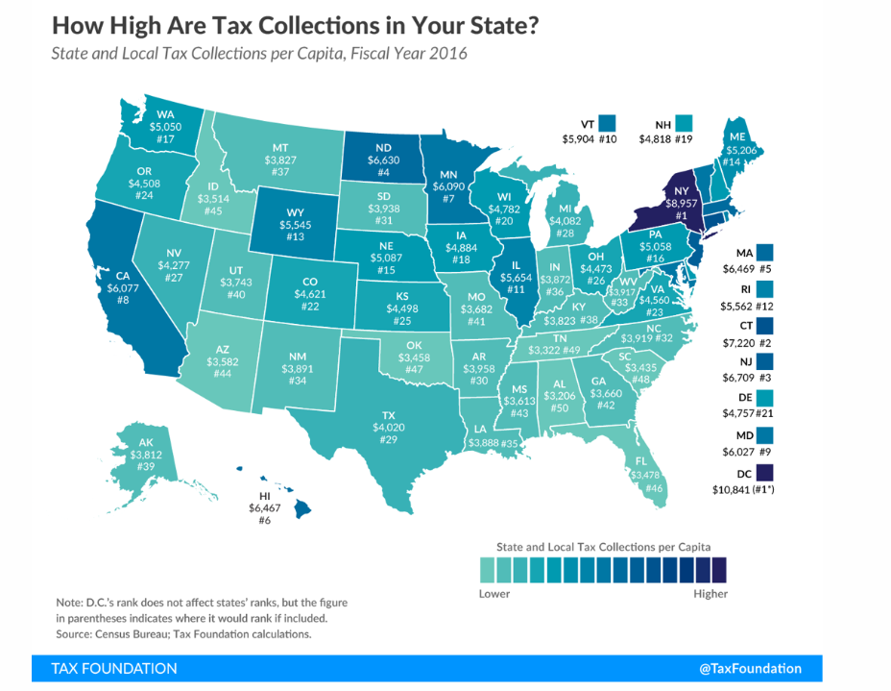
Misinformation – We are not extremely over taxed
Tax Collections per Person, FY2016
General Revenue as a Percentage of Personal Income, FY2016
New York
Connecticut
New Jersey
North Dakota
Massachusetts
Hawaii
Minnesota
California
Maryland
Vermont
Illinois
Rhode Island
Wyoming
Maine
Nebraska
Pennsylvania
Washington
Iowa
New Hampshire
Wisconsin
Delaware
Colorado
Virginia
Oregon
Kansas
Ohio
Nevada
Michigan
Texas #29
Arkansas
South Dakota
North Carolina
West Virginia
New Mexico
Louisiana
Indiana
Montana
Kentucky
Alaska
Utah
Missouri
Georgia
Mississippi
Arizona
Idaho
Florida
Oklahoma
South Carolina
Tennessee
Alabama
New York
Hawaii
North Dakota
Maine
Vermont
Minnesota
Rhode Island
New Jersey
Illinois
West Virginia
California
Iowa
Connecticut
Maryland
Nebraska
Mississippi
Wisconsin
Wyoming
New Mexico
Arkansas
Massachusetts
Ohio
Delaware
Pennsylvania
Oregon
Kentucky
Nevada
Kansas
North Carolina
Louisiana
Michigan
Washington
Utah
Indiana
Colorado
Arizona
Texas #37
Montana
Idaho
Georgia
Virginia
South Carolina
Missouri
New Hampshire
Oklahoma
Alabama
South Dakota
Tennessee
Florida
Alaska
Notes:
First – Overall Burden
Dollars per person – 29
% Income – 37
Bottom Half
Not over taxed
Invest more in education and roads
Whipping Post – Property Taxes & Local Elected Officals

Slide 2
In state and local tax revenue as a % of personal income, Texas ranks 37th!
Rhetoric vs. Reality
Personal Income Tax (PIT)
Sales Tax
Property Tax
Source: Tax Policy Center, Texas Comptroller of Public Accounts
Notes:
37th
No PIT
Higher PT and ST
2006 - Empower Texans blamed local – skyrocketing increases
Pie Chart
Broken Formula
Penalizes local taxpayers → Rising property values
2017 - $8 Billion
Cities & Counties – 16% Each
Unfunded Mandates
Let’s Look….

Slide 3
A better perspective 2007-2017
The State
Perspective…
The Local Perspective
Entity/Category
% Increase
$ Change per
Capita
2007 Per Capita
2017 Per Capita
City Tax Levy
63%
$333
$467
$134
County Tax Levy
65%
$245
$338
$93/$28
School Tax Levy
70%
$792
$1,138
$346
Source: Texas Comptroller of Public Accounts, U.S. Census Bureau, Author’s Calculations
Notes:
Perspective – Sky not falling
Paul Harvey
Percentages vs. Dollars
Length of Time
Population Increase
Per person
Folks – 10 Years, not skyrocketing

